Slide 1
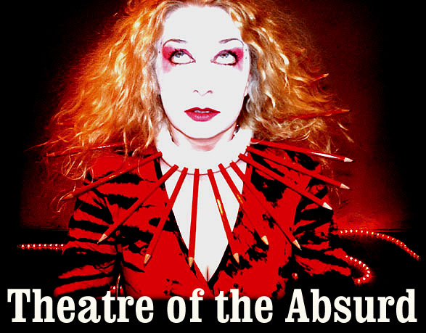
A term first coined by Albert Camus.

Slide 2
Absurdism links very closely to existentialism.
So, why are we here?
There is no reason.
Meaningless, purposeless.
Turn to faith or religion.
God is there to make up for lack of meaning.
Renders everything we do, every decision we make absurd.
What is the purpose of God?

Slide 3
Theatre of the Absurd
Mainly 1950s/60s
Reaction to WWII
Trauma of living post 1945
Existential psychology brought to the stage

Slide 4
Elements of Absurdist Theatre
Deviated from traditional plots
Circular narrative
Unrecognisable set
Dialogue doesn’t seem to make sense
Meaningless action

Slide 5
Breath – Samuel Beckett

Slide 6
“We give birth astride a grave”
- Waiting for Godot

Slide 7
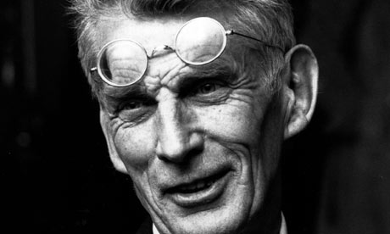
Beckett
April 13th 1906 – December 22nd 1989
Born in Ireland
Travelled Europe and settled in Paris.
He became friends with James Joyce
Failure of humans to communicate
Futility of life

Slide 8
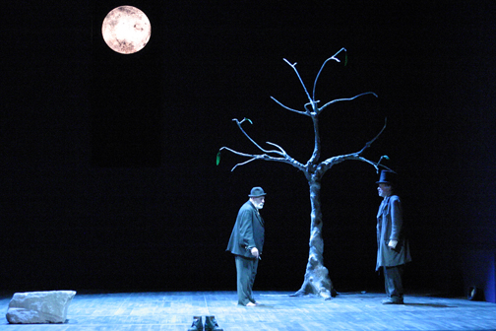
Waiting for Godot

Slide 9
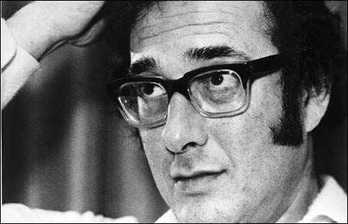
Pinter
10 October 1930 – 24 December 2008
Actor turned playwright
Never offers an explanation
Outside forces interrupting stable environment
His setting is what sets him apart from other absurdist practioners, it is realistic.
Last year, Pinter was on the A2 literature exam paper.

Slide 10
Why is this important?
There is still a place today for absurdist theatre.
It is important to be able to pick out conventions of different dramas and know where influences come from.
People will always struggle with the ‘big questions’ and will attempt to explore it in different ways.
A2 Lit – Wider reading
For all students – it is important to have an appreciation for all sorts of literature and it will always enrich your work.
At Uni – you will appreciate it.

Slide 11

And finally…
Absurdism can still be found today.
I was watching Roger and Val the other night and couldn’t believe how absurd it was…

